Slide 1
Popularity Recommendation System

Slide 2
Introduction
It is a type of recommendation system which works on the principle of popularity and or anything which is in trend.
These systems check about the product or songs which are in trend or are most popular among the users and directly recommend those.

Slide 3
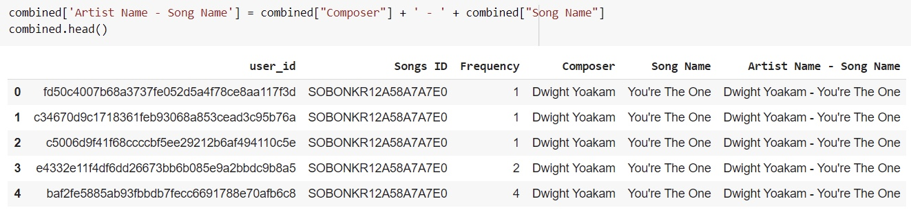
The first step is to combine Composer and Song Name in a single column
After combining we need to find the percentage of Songs with respect to Frequency

Slide 4
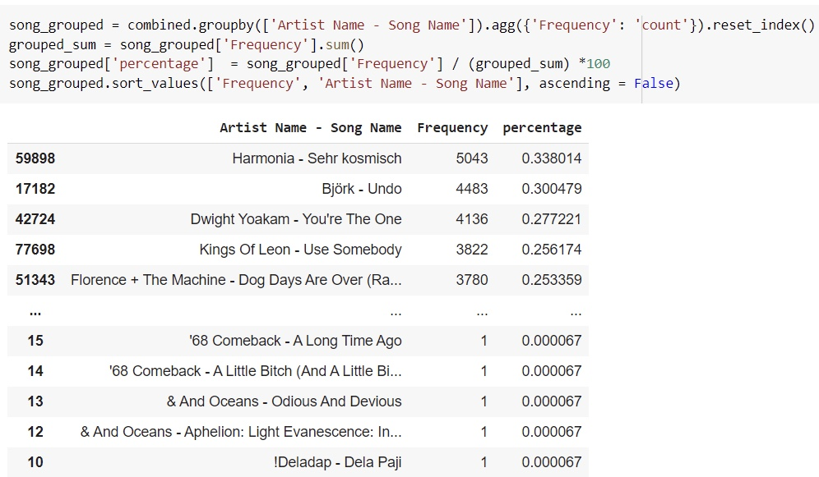

Slide 5
Train Test Split
Since we have a huge dataset we split the data into training and testing dataset.
Through this, we can minimize the effects of data discrepancies and better understand the characteristics of the model by building the recommended system.
import sklearn
from sklearn.model_selection import train_test_split
train_data, test_data = train_test_split(combined, test_size = 0.20, random_state=0)

Slide 6
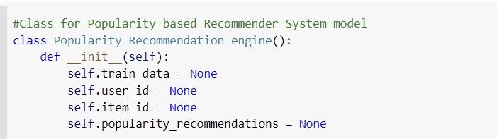
Python Code for Creating a Popularity Recommendation Engine

Slide 7
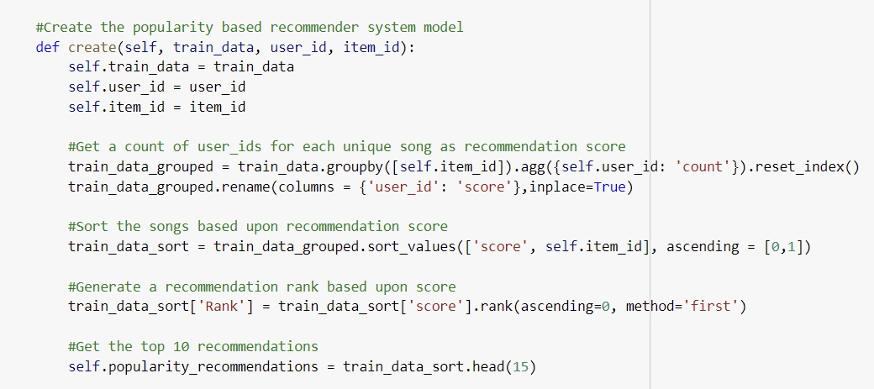

Slide 8
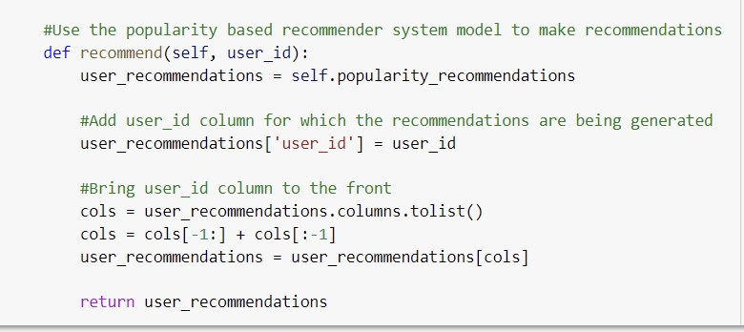

Slide 9
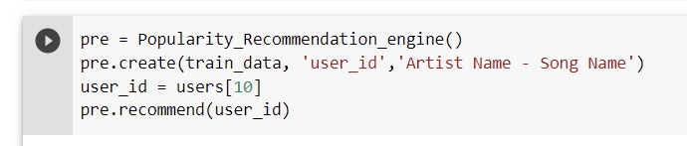
After creating a popularity recommendation engine we need to recommend it to the users.
Here we recommended top 15 most popular songs in the given dataset to the user of index 10.

Slide 10
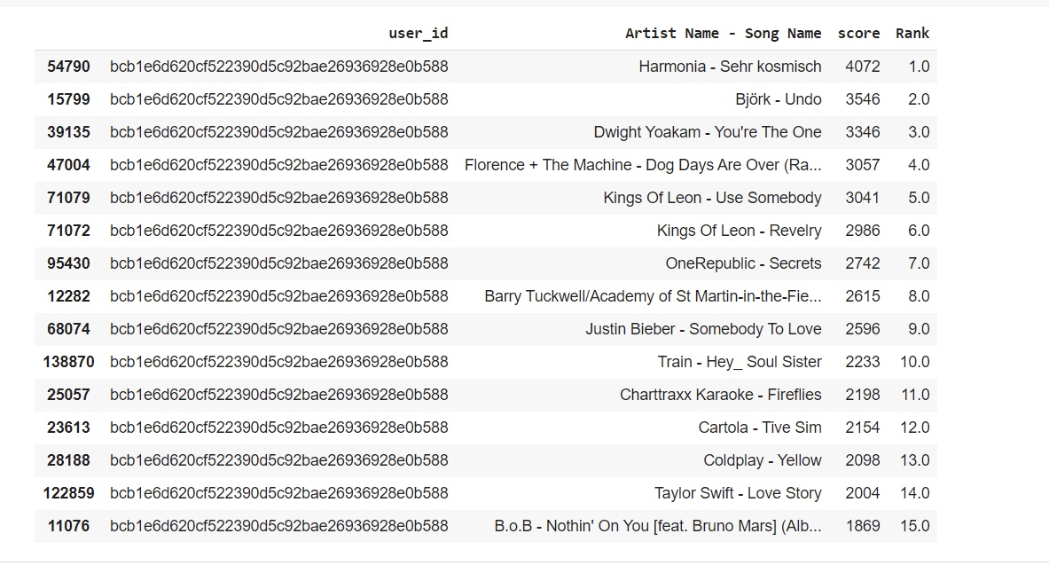
TOP 15 SONGS BASED ON POPULARITY

Slide 11
Cold Start Problem
This problem arises when new users or new items are added to the system, a new item can’t recommend to users initially when it is introduced to the recommendation system without any rating or reviews and hence it is hard to predict the choice or interest of users which leads to less accurate recommendations.
For example, a newly released movie cannot be recommended to the user until it gets some ratings. A new user or item added based problem is difficult to handle as it is impossible to obtain a similar user without knowing previous interest or preferences.

